Slide 1

Sprint 4 Presentation
Golf Player Time Management
Adam Horle, Alyssa Beeker, Bailey Carlin, Daniel Teel, Elijah Hunt

Slide 2
Course Registration
Implemented as part of the registration processes for an account
Stepper with 2 steps
Find your course
Create account
Google Places autocomplete
Cannot narrow it down more than an establishment type so a verify button was added
Checks if course name is already taken
Enter and reenter the password
More descriptive error messages

Slide 3
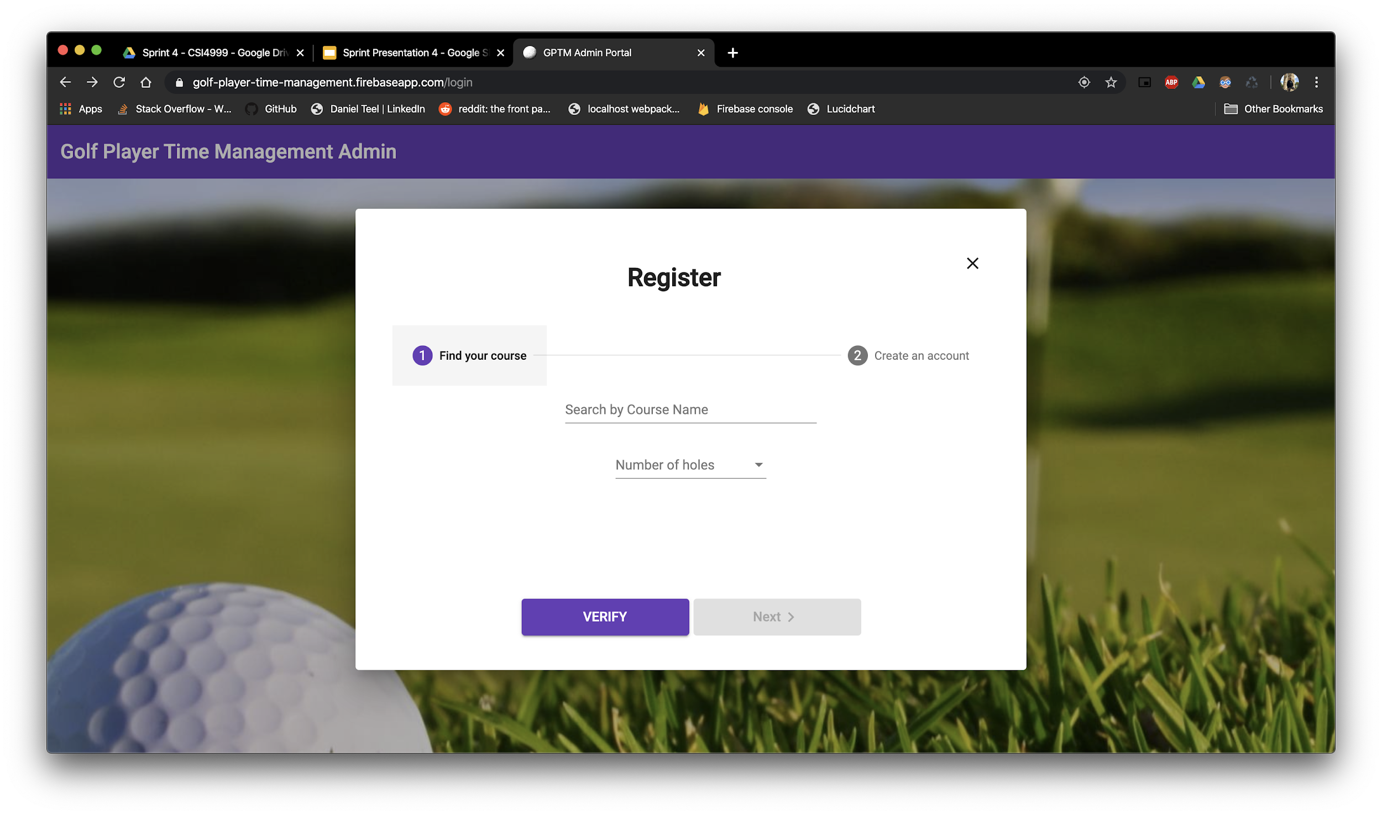
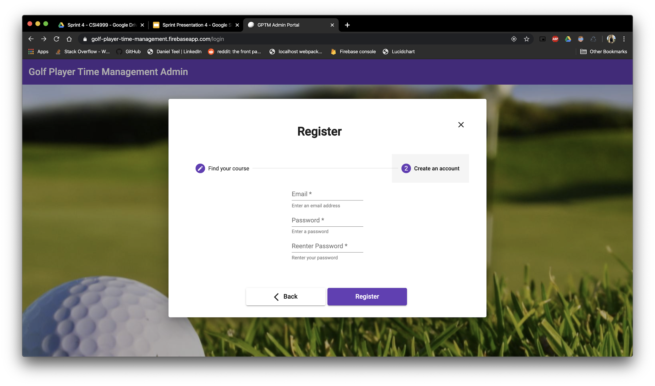

Slide 4
Course Overview
Accordion changed to nav list with nav content
Nav content has 5 main cards
1 for general info
4 for the different difficulty classifications
Edit functionality
Map button opens a window for users to draw the hole boundaries

Slide 5
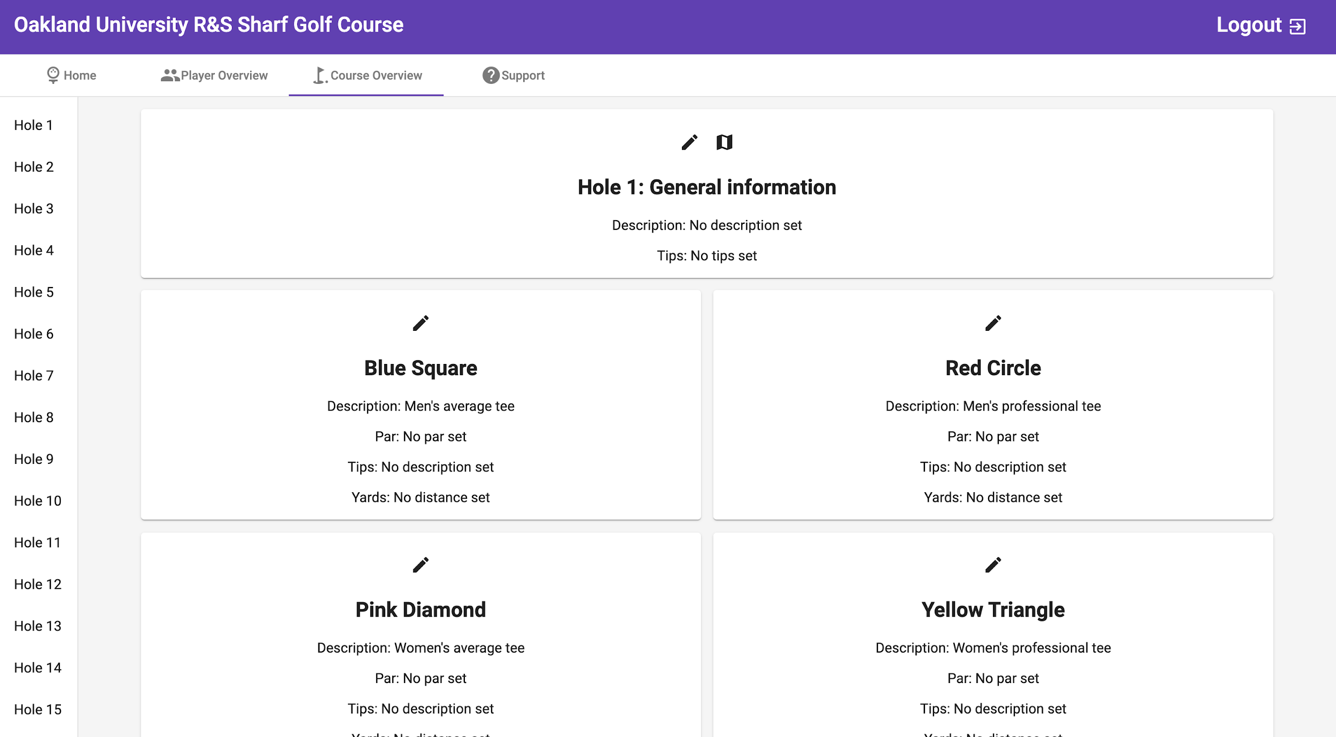

Slide 6
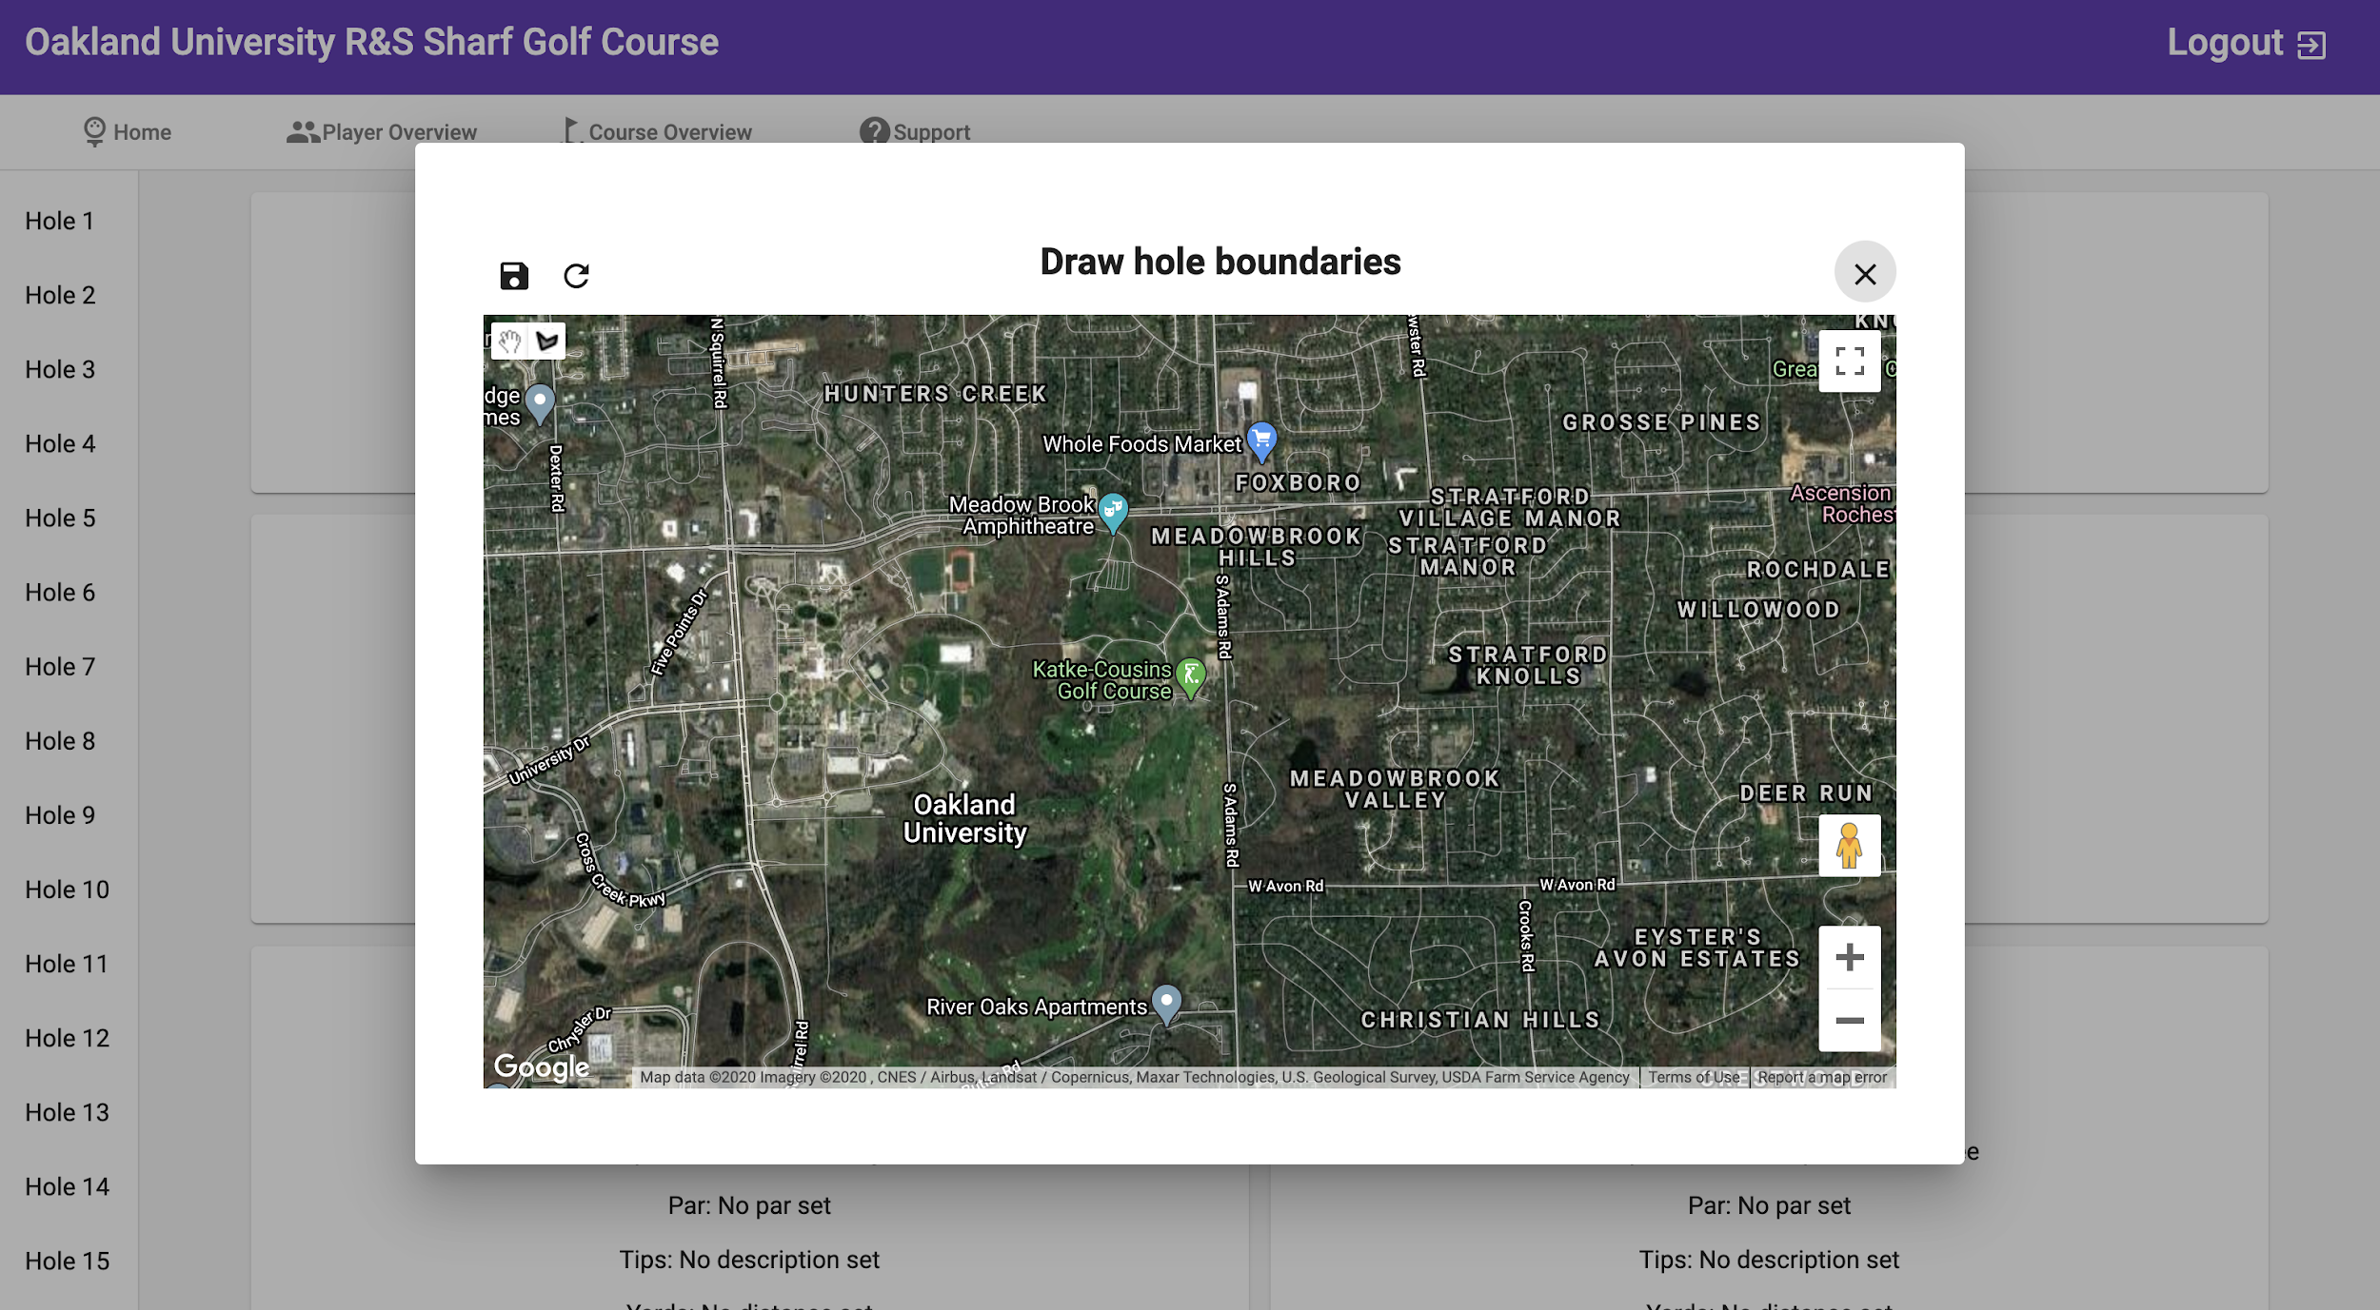

Slide 7
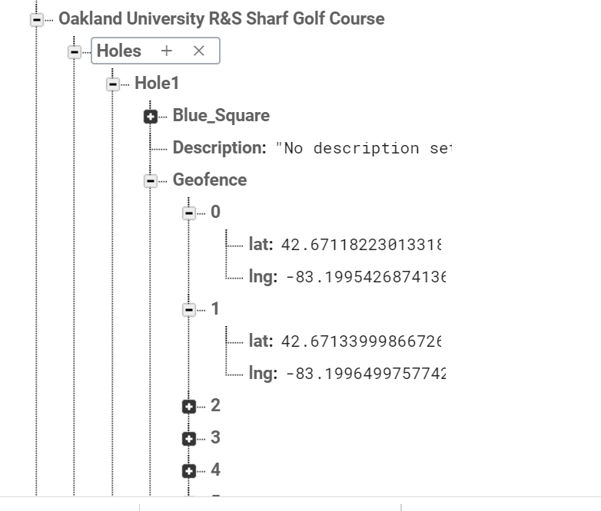
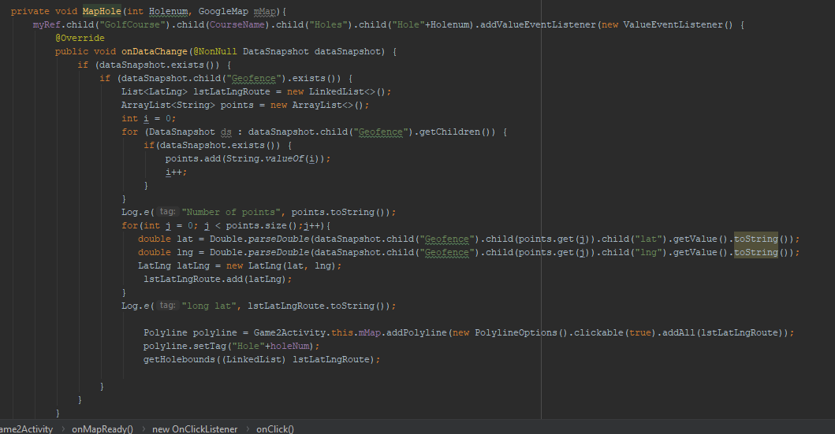
Mobile Map

Slide 8
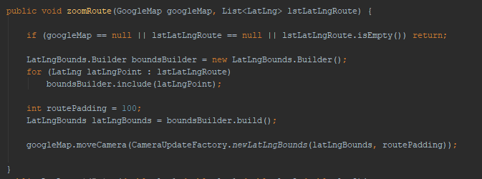
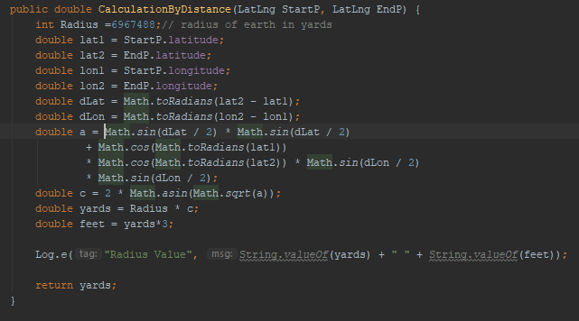
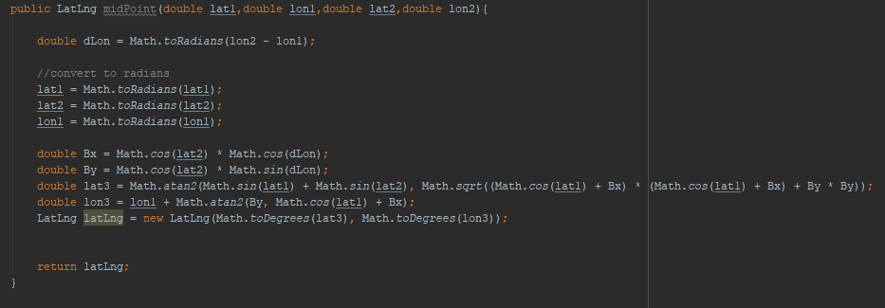
Other Map Methods

Slide 9
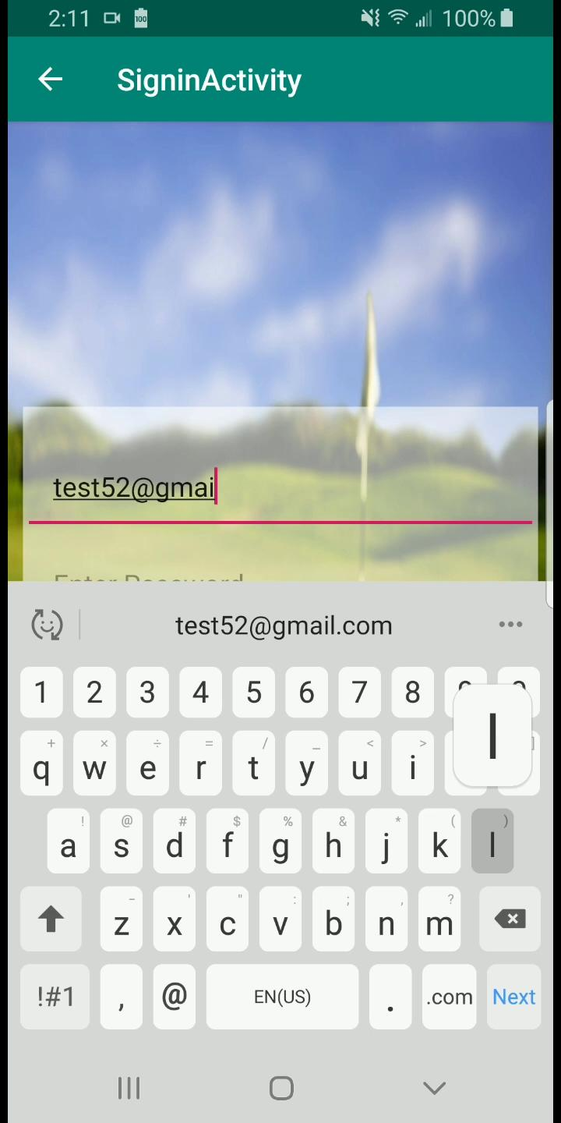
Mobile Map Demo

Slide 10
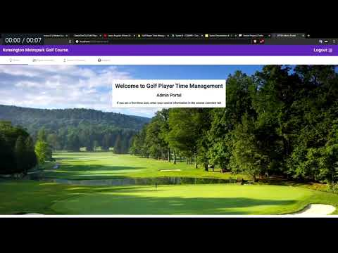
Desktop Requests

Slide 11
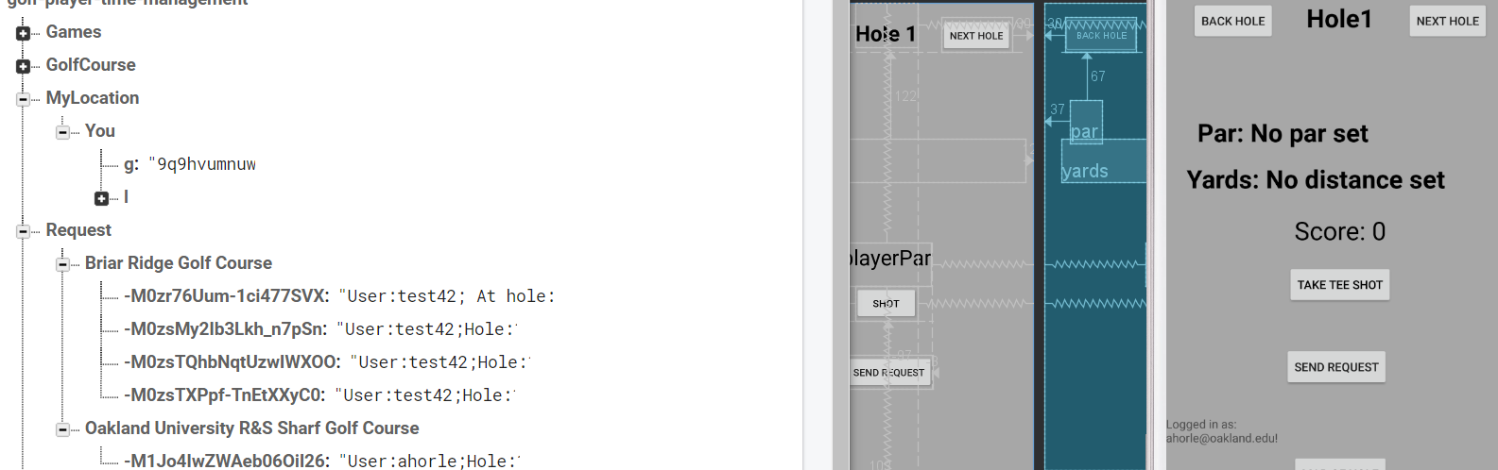
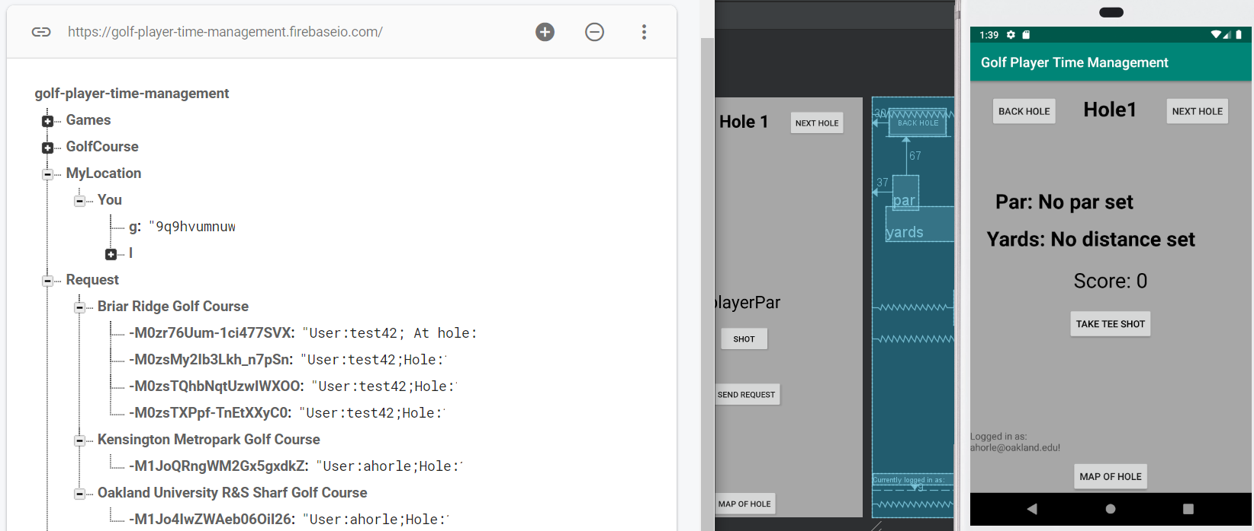
Mobile Requests

Slide 12
Next Sprint User Stories and UI/UX

Slide 13
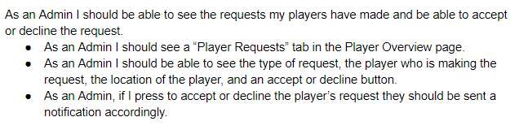
Request Assistance Admin User Stories

Slide 14
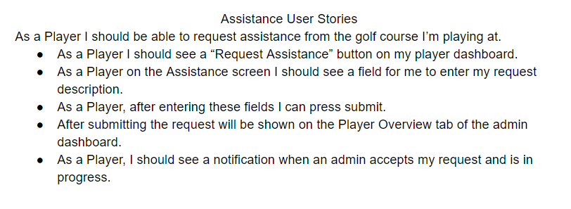
Request Assistance Player User Stories

Slide 15
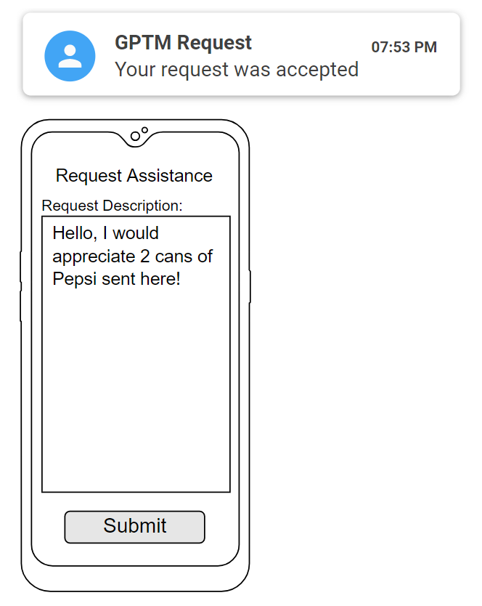
Request Assistance
Mobile App (Player)
Possible Notification
List of categories, no entering text

Slide 16
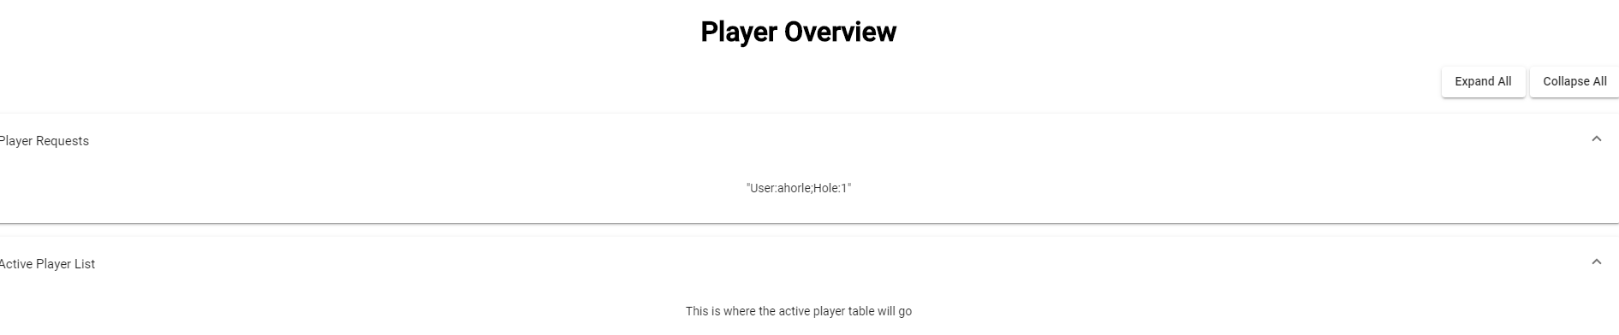
Desktop Requests

Slide 17
Game Speed User Stories
As a player I would like to know the estimated time on this hole.
As a golf course owner I would like to set an upper limit on play time on certain holes so I can get more people through my golf holes.
As a player I would like to know how long it would approximately take me to get to the next hole. (i.e. shows next player in lines current time)
As a player I would like to know what position I am in in the virtual line.
As a player I would like to know how long I have been currently playing on a hole.

Slide 18
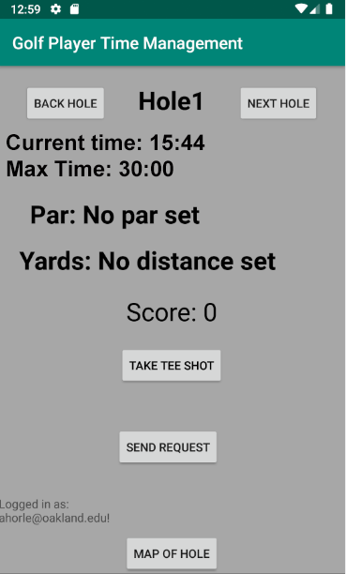
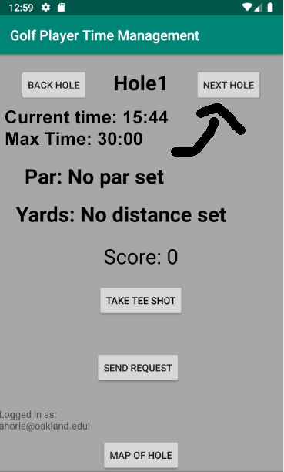
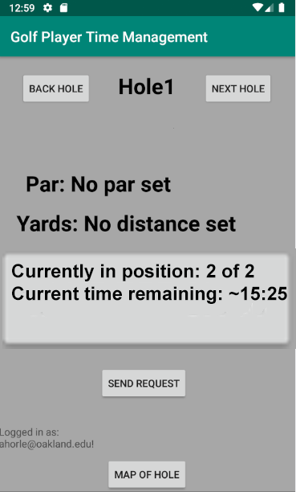
Game Speed UI/UX
------->

Slide 19
Player Overview User Stories
As an authenticated administrator, when I select the Player Overview tab then I will be redirected to the Player Overview tab that houses player data for active users at my course.
As an authenticated administrator who is on the Player Overview tab there are two headers: Player Requests and Active Players.
As an administrator, I would like the Player Requests accordion to house a table of requests that shows:
The type of request
The player making the request
The player’s location
An action button to acknowledge the request to let the player know that the request is in the process of being fulfilled
As an administrator, I would like the Active Players tab to have data pertaining to who is playing and where. The table should include:
Player name(s)
Player locations
Running clock of play time

Slide 20
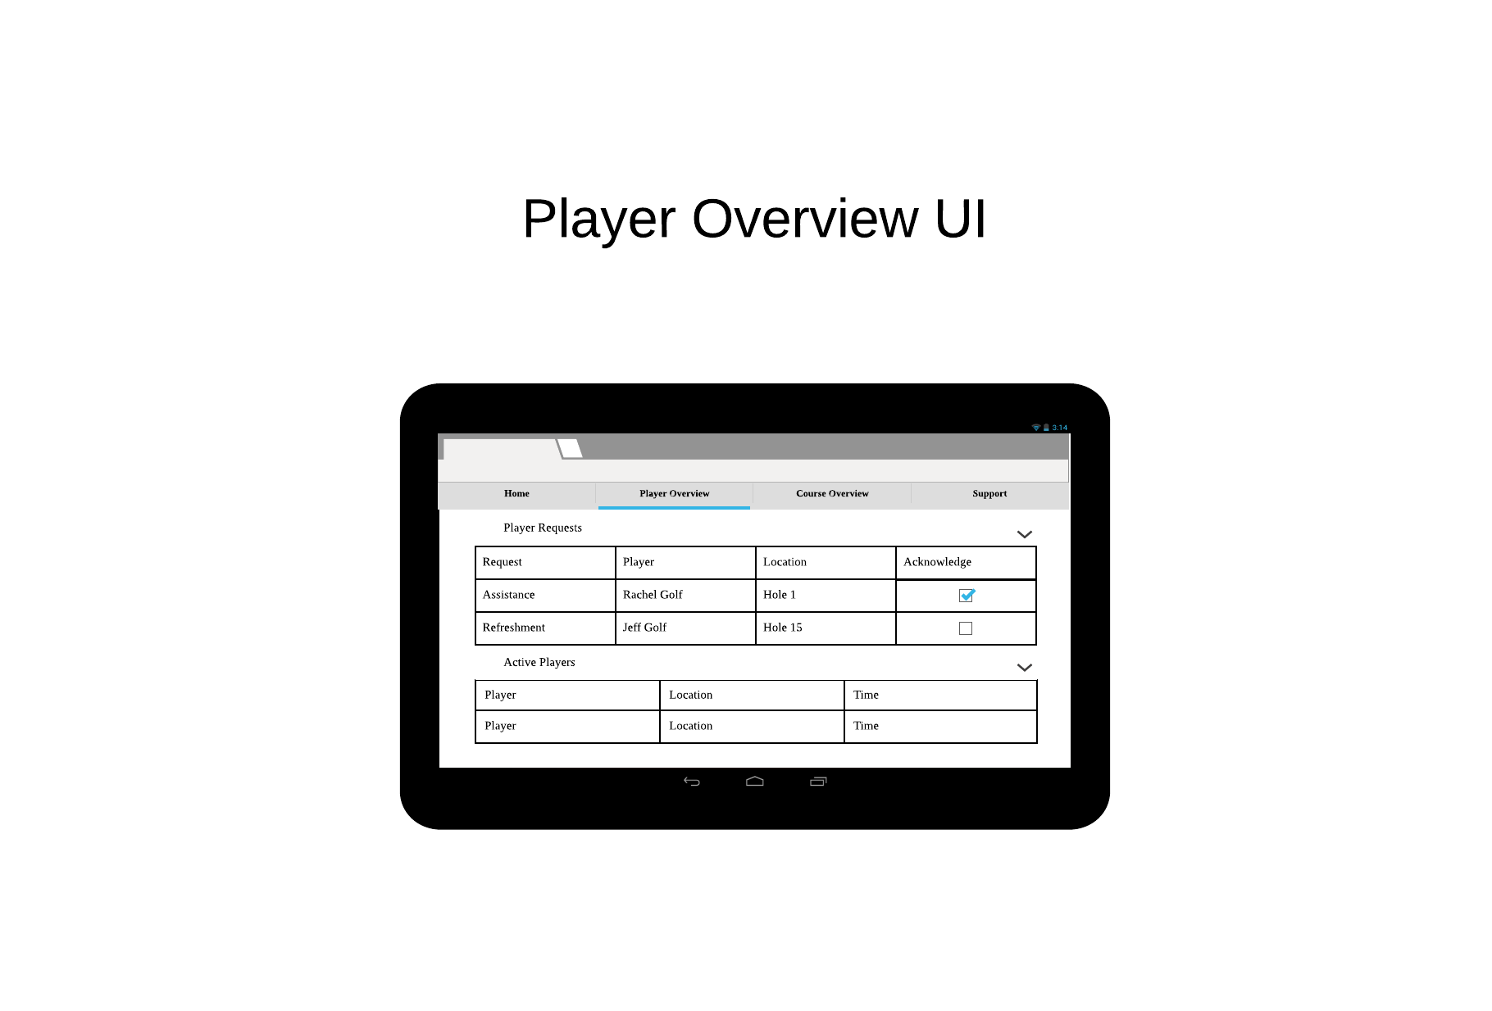
Player Overview UI/UX

Slide 21

Challenges Encountered
Scheduling conflicts and time shortages (break)
CSS annoyances
Learning about Google Maps API
Communication
AngularFireDatabase being a pain

Slide 22

Sprint 5 Web App Objectives
Develop Player Overview tab in the Admin Dashboard
Table of active players with an action menu
Complete player requests and assistance functionality
Continue to churn out documentation

Slide 23
Sprint 5 Mobile App Objectives
Work on UI for all activities.
Map out the Teeing point and Hole for each hole.
Calculate player distance from the hole.
Add a join current game feature.
Set time stamps spent on each hole.
Create Communication between admin and player for assistance request.

Slide 24
Demo Link
https://golf-player-time-management.firebaseapp.com

Slide 25
Questions

